Slide 1
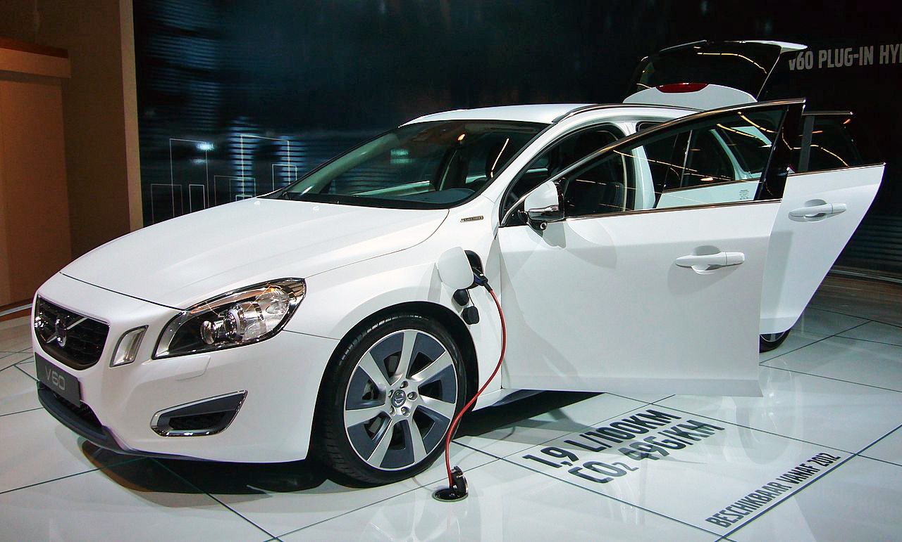
Using models to Scale agile mechatronics
Case studies at Volvo Car Group
Jonn Lantz
Technical Specialist, Electric Propulsion Systems @ Volvo Car Group
Jonn.Lantz@volvocars.com
Notes:
>>> on behalf of the organizing committee of the 17th International
>>> Conference in Software Product Line Engineering (SPLC), it is my
>>> pleasure to invite you as a keynote speaker. The conference will
>>> take place in Florence, Italy, September 15 - 19, 2014.
>>>
>>> The conference brings together about 200-300 researchers and
>>> practitioners working on methods, techniques, and tools for
>>> efficient and effective development of product lines --- software
>>> and systems that exists in many different variants and configurations.
>>>
>>> We hope that in your talk you could share your experience and
>>> insights on introducing model-based engineering using agile
>>> approaches at Volvo. Agile development offers a fresh perspective in
>>> the context of traditional of software and systems product lines
>>> such as cars, which the SPLC audience will likely appreciate and
>>> find interesting.
>>>
>>> Your keynote would be an exiting and highly motivating experience to
>>> the attendees and especially the students and young researchers
>>> attending the conference. We would be highly honored by your presence.

Slide 2

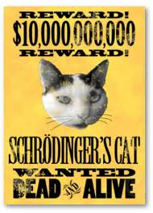
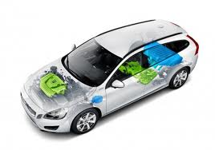
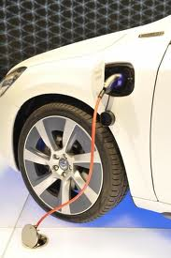

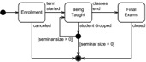
About me
Technical Expert in CI, Electric Propulsion Systems
Volvo Cars
About Volvo Car Group
Mechanics
Power
Electronics
Software
Automotive mechatronics
Quantum
Physicist
-2005
Mechatronics
Power
engineering
A trinity for sustainable automotive business!?
Technical Expert
Continuous Integration
Research collaboration
Teacher
-2007
Volvo Car Group – Green, safe, premium cars!
Climate change; new legislations (often regional) …
Exponential increase of software in cars…
Modern cars are product lines of complex distributed software in moving, safety critical, (high voltage) volume mechatronics
Sw developer & change driver
at Volvo Cars -2013

Slide 3
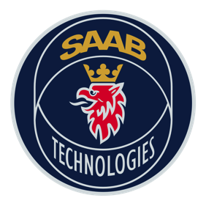

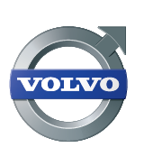
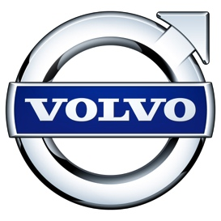




Software Center
Mission: Improve the software engineering capability of the Nordic Software-Intensive industry with an order of magnitude
Theme: Fast, continuous deployment of customer value
Success: Academic excellence
Success: Industrial impact

Slide 4
Aim
Activity
#1 Background. Why are we doing this?
Assessment

Slide 5
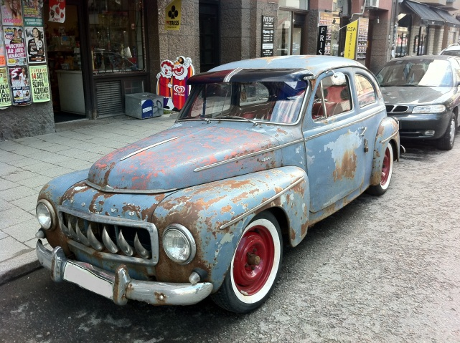
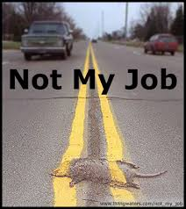
The Automotive challenge #1
Working with embedded software? Then you are 20 years behind!?
Why?
A modern premium car can have about 100 ECUs (embedded computers) working in a complicated network
So, the system is not 20 years behind! Can we solve this? What will be required in the (near) future? How fast must we get?

Slide 6
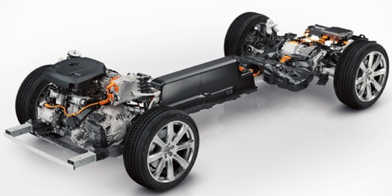
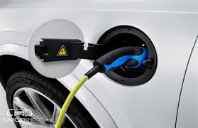
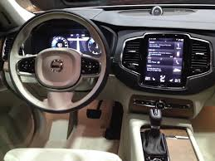
The Automotive challenge #2
Modern premium cars comes with numerous options
We cannot test vehicles with all possible combinations! There are simply too many…
This includes several hybrid variants – i.e. variants of the mechatronic drive train. Mechanics and software are closely connected.
Consider a product line with 5-10 hybrid/mild hybrid/standard models…
We are not there yet, but almost, and the challenge has to be considered now.
Note also that a car [hardware] is designed to last for ≥10 years. Its like selling volume space probes…

Slide 7
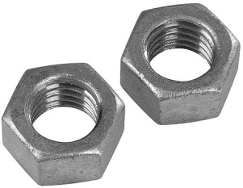
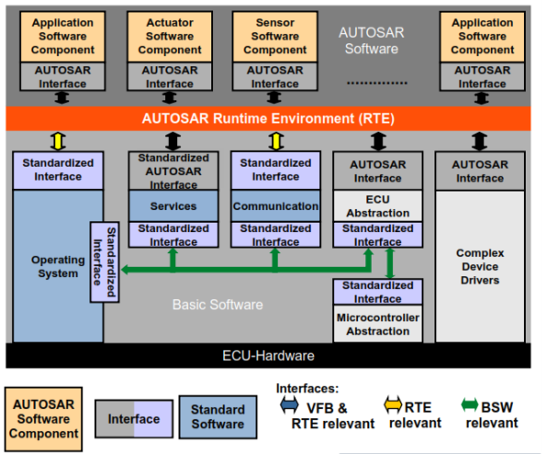
The Automotive challenge #3
The material cost (still) dominates
If there is a new ECU, CPU, …, which save us a dollar it will be choosen. Hence, we work on unstable platforms and changing Tier1 suppliers.
AUTOSAR is an attempt to create a standardized embedded ECU-system with applications, but the platform independence is still not here yet.

Slide 8

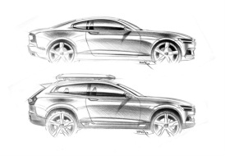
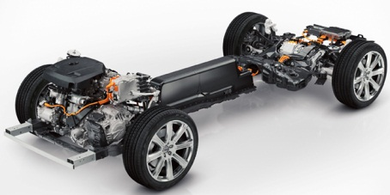
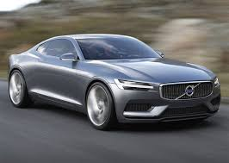






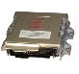
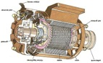
Approaching scaled mechatronics, the first step
Secondary software development; sw dev & integration support (continuous flow)
In-house teams work in parallel, but can meet and discuss.
Short loops are possible.
Loop
back
Design (plan)
Integrate in platform
(and system rig test)
Test with vehicle
Distr.
In-house
development
Local design (requirements)
In-house
Out sourced
Local rig-test (HIL)
Too slow!
Too frustrating!
No innovations! Slow product line dev.
(one by one…)
ECU/sw
platf. dev.
Massive
parallel
development!
Big bang integration
Supplier system dev.

Slide 9

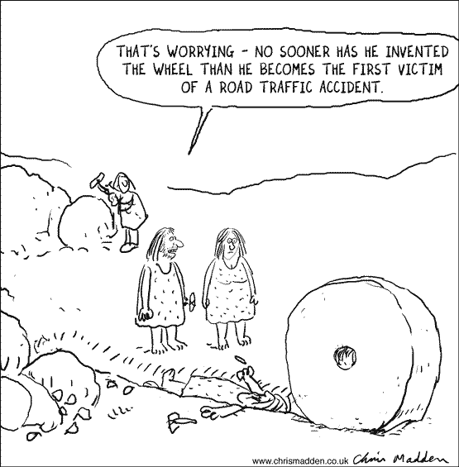
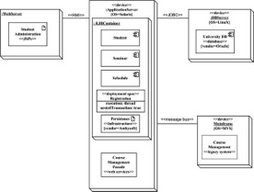
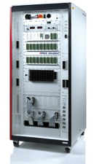


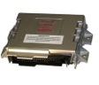

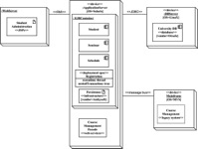
Change!
From requirement engineering to in-house (software) development!
From requirement engineering (with requirement as core object)
Lost knowledge if supplier is replaced!
… to in-house development,
but still struggling with slow feedback
ECU & SW
Supplier (Tier1)
... and aiming for Continuous Integration with control models as the core objects for development.
Send to supplier
Wait…
Test vehicle
System design
(architecture attempt)
Development
Detailed requirements
(solution attempt, in word)
Test if it works (as you want).
Requirements
(wishes, ideas, …)
Photo: dSpace
High level
requirements
MIL, HIL test, integration
Test vehicles
Virtual
test
(MIL/HIL)
Executable model
as core object!
ECU
supplier
Research
Architecture (moderating role)
Feedback!

Slide 10
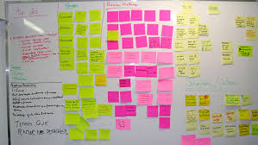
In-house as solution?
Invest in in-house development!
Key software and hardware are easier to loop and optimize in-house. We gain speed and save money
In-house enables [prepared] scaling and control over variants.
The drawback is increased fixed cost. We cannot design the complete car in-house… Prioritization becomes important.
It takes time to establish the essential (agile) methods. Both competence and mind set has to change.
Ideally we should combine in-house solution with “of the shelf” components… But, reality is unfortunately more complex.

Slide 11
.5
#2 Modeling

Slide 12
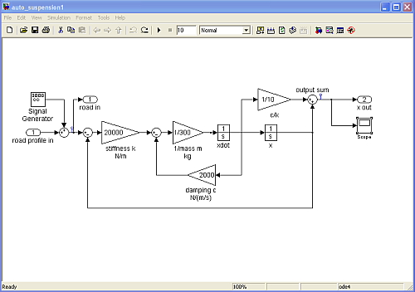
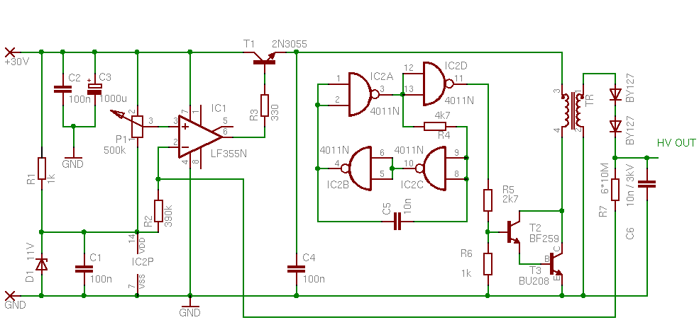
Using Models to have domain experts as programmers
MDE driver #1: Software modeling (low level, not UML) is a good way to introduce control software development!
Domain experts (mechanics, electronics, power electronics…) are usually not software experts.
Domain Specific [programming] Languages (DSLs), like Simulink, will allow domain experts to develop code.
Simulink (used at VCC) provides an abstraction suitable for not too complicated control systems. Most people used to control algorithms can understand a Simulink model…
H. Burden et. al. 2013

Slide 13

The modeling abstraction level
There are pitfalls in modelling!
Simulink succeeds (at VCC) since the level is low, close to c, as long as the models are kept small. And, since the models can be executed, with ”almost on target”-properties.
UML has failed* in similar setups since The Model becomes too complicated and difficult to maintain. A model which is not executable will inevitably grow over time. Code generation from a too complicated (meta) model becomes unmanageable.
Graphical languages (popular) works for small models – or you end up in spaghetti.
It is very important that the models can be executed with realistic behavior
Models must be kept small
*See e.g. R. Heldal et. al. 2014 (please ask for more exact ref…)
Abstraction
level
UML, Sys-ML
Simulink
C, C++

Slide 14

The devil is in the detail
Know your box!
Lower level modelling languages have an advantage: the box can be fully understood.
Development is very much about understanding the system – therefore low level languages succeed.
The box provides abstraction (of the generated code), but it is still easy to understand the function and code it produces. We can also configure the box, without complicating it too much.
This put tough constraints on the abstraction level. It usually cannot be as high as we would like…
box
.5
/* Product: '<S21>/Product11' */
rtb_TmpSignalConversionAtEngNSafe_EngNSafeOutport2.EngN * .5F;

Slide 15

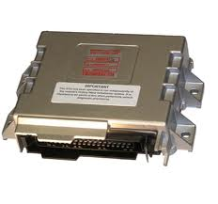
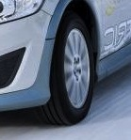


Model driven engineering (MDE)
MDE driver #2: Test your (sub) system before it exists!
Virtual integration is the art of creating test environments for control software, before the actual components (products, or product lines) are available.
Virtual integration in mechatronics requires Plant models (device models) and Environment models (e.g. a road).
Software models
Developers
Plant Models
Controller (ECU)
Environment models
Power supply, Network,…
Device
Note: Plant models are primarily useful where closed loops (controller-device/env.) exists
Supplier(s)

Slide 16
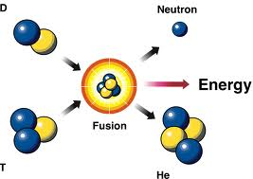
#3 Agile. Continuous Integration. Speed.

Slide 17
Agile development
Pay to learn early
Gain knowledge early in projects to avoid workload peaks near deadlines!
V-model
”waterfall” process
Agile (test driven) process
decision
Decisions!
system
is verified
system
Succ.
handovers
component
component
knowledge
knowledge
Time/readiness
Time/readiness
NOTE: Test and test automation is the key

Slide 18
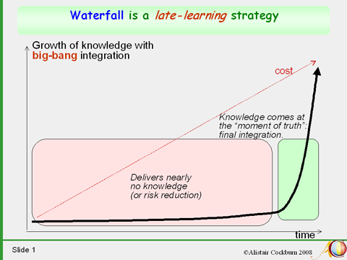
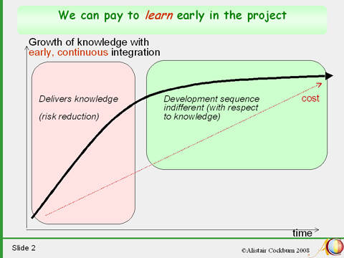
Agile development

Slide 19
Learn early by making plant models!
Model Driven Development – Create virtual verification environments!
Although the mechanics, ECU-platform and other mechatronics are not yet delivered, plant models
can be designed – using the best knowledge – and used for early continuous virtual integration.
Some assumptions will be proven faulty, but we learn much faster (compared to not use MDE)
(Ulf Eliasson et. al, presented soon at MODELS 2014)
still a knowledge gap,
but much smaller!
development based on assumptions
Knowledge
first integration
Simulink
subsystem control sw
modeling,
delivers
knowledge
plant model
time

Slide 20
Model driven engineering; lessons learned
Approaching Scaled MDE
Best result if we combine Domain expert sw development with efficient Virtual Verification
Automated (fast and easy) integration (model based and real) is essential!
Define modeling domains, build competence and knowledge
Reach platform independent development (e.g. utilizing AUTOSAR)
We usually underestimate the resources needed for testing
Domain experts as developers
3. Plant &
Environment models
1. System models
Controller (ECU)
Power supply, Network,…
Realistic system test results, early
Device
Realistic functional
test results, early
Supplier(s)
2. Platform models
Platform
independence?

Slide 21
Tutorial: Testing in MDE & mechatronics
Modeling comes with new abbreviations:
MIL = Model in the Loop (that is, test the model itself in a modeled environment). Verify the function (and validate your requirements). Note: At VCC Unit Test is conducted at this level.
SIL = Replace the Model above with its generated code. Verify the same behavior.
HIL = Integrate the generated code in the real ECU, but model everything outside the ECU. Verify that the platform does not interfere with the function.
Note that all three steps above can be automated. Especially the two latter steps are suited for automated regression test – (Virtual) Continuous Integration – locally (sub systems) or with other ECUs and other real devices (box car, system HIL).
Then we can go to the car
.c

Slide 22
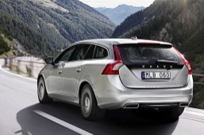
The Model Driven process
Re-invent the classical V-model!
Continuous Deployment
short loop
System
High level
reqs.
System
MIL
RIG
CAR test
Vehicle
integration
SW
ECU
System design tool
(database)
MIL-SIL short loop 1h
MIL
(SIL)
SYS/MECH
HIL
HIL short loop 24h
Plant models
ECU
Architecture
Simulink
ECU integration
code
gen
Simulink & Simscape
SW
Design
Unit
test
Developed by Tier1 from
requirements
SW Component

Slide 23
… and in real life
ECU
ready!
Vehicle
ready!
System
High level
reqs.
CAR test
RIG
SW
ECU
System design tool
(database)
Vehicle
integra-
tions
SYS/MECH
HIL
(continuous ECU-integration
possible)
Plant models
ECU
ECU
integrations
Simulink & Simscape
SW
Design
SW Component
HW Assumptions made
Assumptions verified

Slide 24

#4 Languages

Slide 25
Challenges with agile MDE
SW modeling: Lessons learned:
Some basic agile requirements, as merge, are difficult due to binary or non-textual model file formats.
There are few tools available for testing, automation, CM, etc.
There are no communities for agile modelling
Be prepared to develop your own tools, scripts and CI-environments
Start internal & external communities.

Slide 26
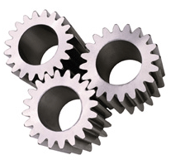
The important secondary software
Internal services are needed to support development
Model transformations
Integration
Test
CM
Automation: transformations, integrations, test, ...
Secondary software is an enabler to model driven agile embedded development
Non-perfect modeling design, test & CM tools
Young standards (e.g. AUTOSAR) having ”dialects”
Specialized build environments
Lesson learned: keep it in-house! Outsourcing of secondary software seldom works, the required flexibility is too large. Speed is important. Knowledge is important.
(the same conclusion as in requirement engineering; you cannot specify what you don’t know)

Slide 27
Mixing domains
Can we inspire sw developers and CAE teams (e.g. physical modeling teams) to collaborate closer?
The goal is to understand the (sub-)system
The sw team and the CAE team has to model in a way which enables co-simulation of different domains
… and perhaps even co-work on a common model?
The models shall be used in automated integration and automated MIL/SIL test
DSL
programming
Developers
Plant Models
+
-
Controller (ECU)
Power supply, Network,…
Environment models
Device
Supplier(s)

Slide 28
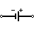

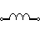
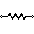
Scaling Model design
If we want to model more of the system – mechanics, electronics, fluid mechanics,…, then a single DSL may not be sufficient
A promising solution is to use different Domain Specific Languages (DSL) specialized for the different domains. Electric Propulsion at VCG has tried out “Simscape” (multi domain modelling, integrated in Simulink) now for 3 years. Other sections are using other languages.
DSLs will allow local organizations to develop faster with better reuse and understanding. The design scales!
U₀
Controller
(PWM)
V(t)
L
R

Slide 29
DSL example: modelling mechatronics
Mathematical representation
Model representation in Simulink
Control V(t)
Graphical representation
U₀
Controller
(PWM)
V(t)
Model using c-code
Model representation in Physical DSL
L
R
…
real MyCircuit_dIdt(t,I,V,R,L,U0) {
return (U0 – V – R*I) / L;
}
/* Use with proper ODE solver */
for(t=0, t =+ dt, t < t_end) {
…

Slide 30
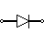
DSL example: modelling mechatronics
Then add one tiny component…

Slide 31
DSL example: modelling mechatronics
Mathematical representation
Model representation in Simulink
Rewrite completely > 2x no of blocks
Graphical representation
Control V(t)
U₀
Controller
(PWM)
V(t)
L
R
Model using c-code
Model representation in Physical DSL
…
real MyCircuit_dIdt(t,I,V,R,L,U0) {
return (U0 – V – R*I) / L;
}
/* Use with proper ODE solver */
for(t=0, t =+ dt, t < t_end) {
…
Rewrite completely > 2x lines of code
V(t)
U₀
L
R

Slide 32
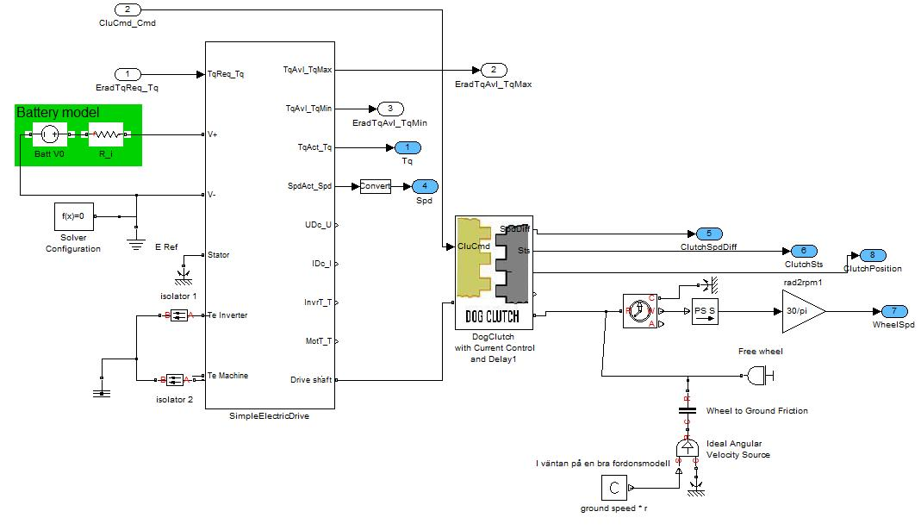
A use case: developing dog clutch control software
function developers
CAE developers
Auto generated
AUTOSAR ECU model
model
reference
library
Plant model (Simscape DSL)
test
developers
Test bench
(combined with test tool)
Results:
Although the first versions of the clutch model had
numerous faulty assumptions, these where easy to
correct – since the developers now understood the
system! (U. Eliasson et. al. MODELS 2014)
automated
regression test

Slide 33
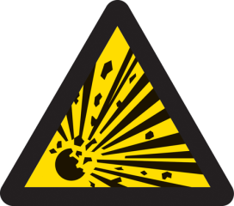
The Importance of Testing
Some people believe that a graphical, high level control model, looking sort of like an executable specification, is so descriptive, so simple that no unit test or regression test is required.
my device
controller
vehicle
integration
test
This is completely wrong
device
unit test
functional test
Although complexity is hidden from the user in Simulink, it will be revealed in the generated code.
Unit Test, (functional) Regression Test and coverage metrics are absolutely essential!
automated
regression test

Slide 34
Note about testing: use the same language!
We know from experience that developers prefer to conduct testing using the same language as they use for development
Thus, if we develop control code using Simulink at VCC, we should develop test cases using Simulink – or in a tool integrated in Simulink with syntax familiar to Simulink users.
This turns out to be tricky…
Formal verification looks very promising!
But should be integrated in the language used by developers. Why not fully integrate testing in the modeling language?
Test vector design and regression test automation
Tools for traditional testing works well
efficient test suite management, parameter set & test execution
fast simulation (minimize compile time, parallel computing, cloud simulation, …) in normal mode (enabling coverage metrics)
Static analysis
Important, but not facilitated yet! Why not integrate this also? The language should help, not trust, the designer…

Slide 35
… and in real life
ECU
ready!
Vehicle
ready!
When available – frequent (continuous) integration on target, with high coverage regression test is essential!
Virtual test is for early learning, real test is for real knowledge! (Thus, HIL must be extended with real mechatronics, real vehicles…)
MDE can be successfully combined with Continuous Integration, but tailor-made tools must be developed (in-house!)
System
High level
reqs.
CAR test
RIG
SW
ECU
System design tool
(database)
Vehicle
integra-
tions
SYS/MECH
HIL
(continuous ECU-integration
possible)
Plant models
ECU
ECU
integrations
Simulink & Simscape
SW
Design
SW Component
HW Assumptions made
Assumptions verified

Slide 36
#5 Scaling agile mechatronics!?

Slide 37
Organizational aspects
An organization is change; from hardware to mechatronics
New processes and agile ways of working must be developed.
Agile has to be adopted to distributed volume mechatronics
Domain experts must gain competence in programming
SW developers must build up Secondary software …
Mechanical ”waterfall” process
Agile mechatronics process
Agile sw team (developers, ECU-tester)
System design
Vehicle test
System design
Vehicle test
Requirement eng.
Integration test
Requirement eng. (mechanics, platform)
(Vehicle) Integration test
Supplier
Sec. SW support
(Secondary sw)
Supplier
Time/readiness
Time/readiness

Slide 38
The triple lane supersprint (beta)
An attempt to manage distributed mechatronics development (sub system level)
supersprint
New functionality (X)
New
functionality
(X)
In-house development on existing platform
Time for
one short
loop
Platform update
Supplier development (ECU & devices)
Func. Ready for verification (Y)
New platform &
software
Verify
functionality
(Y)
(In-house) product verification; vehicle test

Slide 39
Scaling agile mechatronics: agile architecture
At present time agile development (fast looping) over the network is difficult
The CAN network is cheap (we beleave), but not flexible.
Static communication model (periodic signals using a static db) yields full com optimized on a finite bandwidth but also a monolithic architecture -> non-agile
The challenges in modeling (describing, designing, maintaining) the present architecture are considerable -> non-agile
This is an obstacle when scaling agile mechatronics, but not necessarily a complete stopper…
But, yes, the developers would appreciate an open, service oriented, network… However, this has to be studied further.
V-model
Agile!
System detail

Slide 40

#6 Looking forward

Slide 41
Looking forward – approaching product based development
The challenge of parallel development Automotive development is usually project based: massive parallel development and big bang integrations. Early system test is difficult, if possible at all.
The result is spikes in the issue management and incomplete testing of the final product
Typical issue statistics
with ”integration spikes” and delivery cut off
Product
(or prototype)
development on multiple parallel sub-systems
(ad hoc reuse from previous project)
Big Bang
integration
Project Kick off
Delivery

Slide 42
Product driven mechatronics: the virtual product line
We can never have a full [car] product line ready for Continuous Integration
… but using a virtual product (line) it is possible to get closer. Automation is essential! As is an automated model architecture (Avoid parallel architecture models).
Long loop (but faster!)
Short loops
Loop
back
Current product
(virtual)
Virtual system test
Integrate in platform
(and system rig test)
Test with vehicle
In-house
development
Reqs, tests.
Local rig-test (HIL)
In-house
Out sourced
Included in long loop

Slide 43
Scaling Virtual Integration
Full product simulation; complete vehicle MIL
Appealing idea, but comes with considerable challenges:
Multi domain architecture (combine hw and sw architectures.)
Multi domain modeling (integrating electronics, cooling, data, mechanics…)
Multiple DSLs has to be integrated (into one executable model)
Currently working on it…
multi domain bus
subsystem control sw
subsystem control sw
subsystem control sw
subsystem control sw
…
plant models
plant models
plant models
plant models

Slide 44
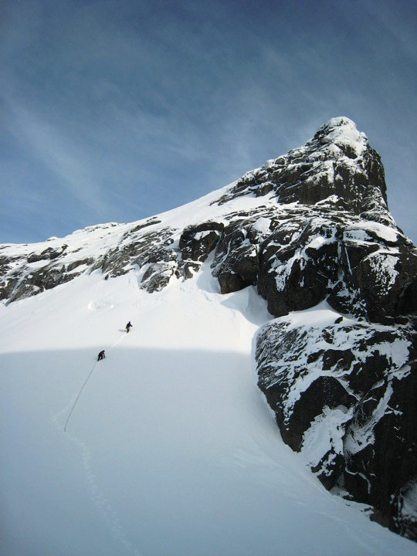

How agile should we be?
Developers, they wanna have fun!
It is great to introduce agile! Get rid of the frustration! Develop and really see that your solution ends up in the vehicle…
This will attract smart developers!
However, if the process is too efficient, too fast we might loose the innovations. Innovations which are done during the normal work…
We want to be an innovation driven company.
… but, we are far from that summit yet.

Slide 45
Conclusions
Volvo Car Group has successfully combined Model Driven Engineering with methods from Agile Software development.
Use cases demonstrate that MDE is an enabler for Agile in complex mechatronic systems.
Continuous Integration (target builds, regression test) is working well, but suitable tools for testing and test automation in DSL-platforms are still missing.
Physical Modeling (DSL) is useful for readable, reusable and scalable modelling of physical systems, but challenging for large scale MIL testing (due to increased complexity and code generation issues)
We invest a lot in Scaled Virtual Verification – but we are not there yet…
Finally, so why are we 20 years behind in embedded SW development?
No clear answer!
Agile is not generic; it has to be adopted (to mechatronics); adoption takes time.
Unstable platforms; the unit price dominates.
No real open source community for embedded software!?
Higher education is more than 20 years behind!?

